Slide 1
DEATHCOLLECTION.COM

Slide 2
PROBLEM
Young people are not realizing the connection between the past and the present
They are not aware that past crimes might repeat (or are repeating)

Slide 3
MESSAGE
Shocking online campaign targeted to young audience in order to realize that things that might appear cool and fashionable are actually products of blood crime

Slide 4
SOLUTION
We have created a fake online store called deathcollection.com, where the audience will be informed, that beautiful products were actually made of blood in the most horrible crimes of our past. All products are pieces explaining the repeating history. And we must learn these facts in order to understand the history and learn.

Slide 5
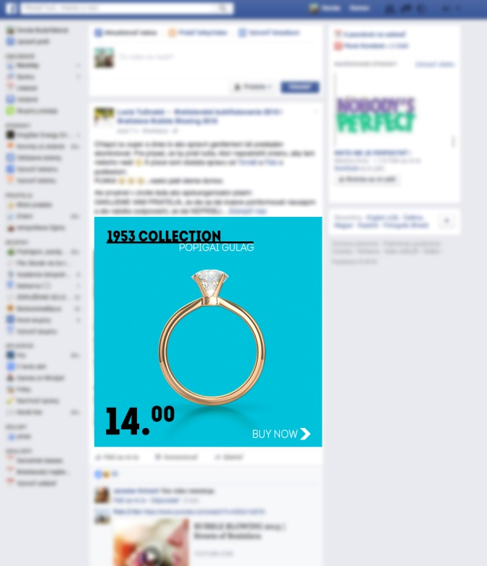
TEASING/ ONLINE CAMPAIGN
specially targeted for young audience on places/networks, where they are – Facebook, Snapchat, Instagram, youth websites , etc.

Slide 6
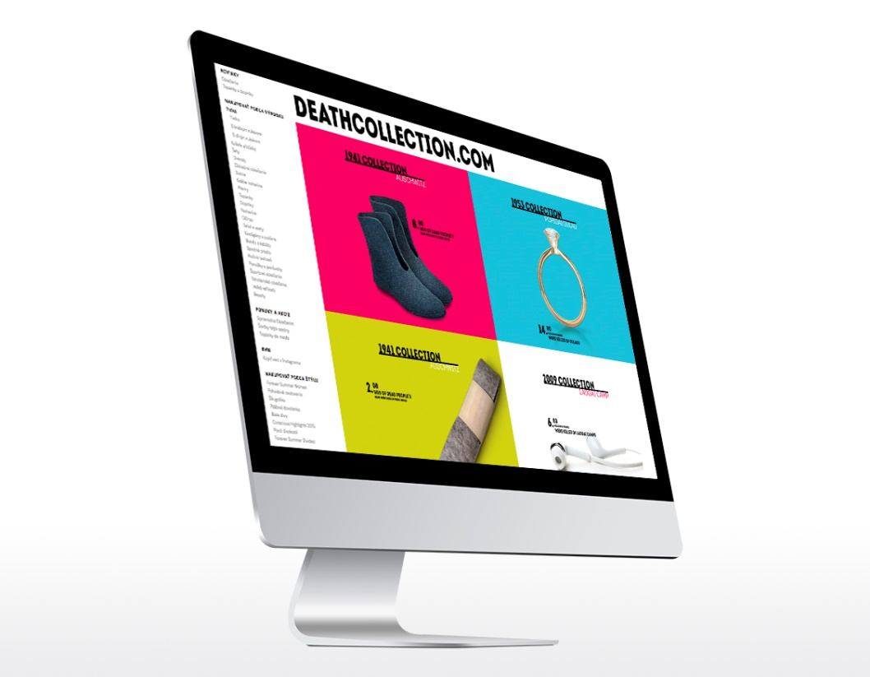
WEBSITE

Slide 7
WEBSITE
REVEAL

Slide 8
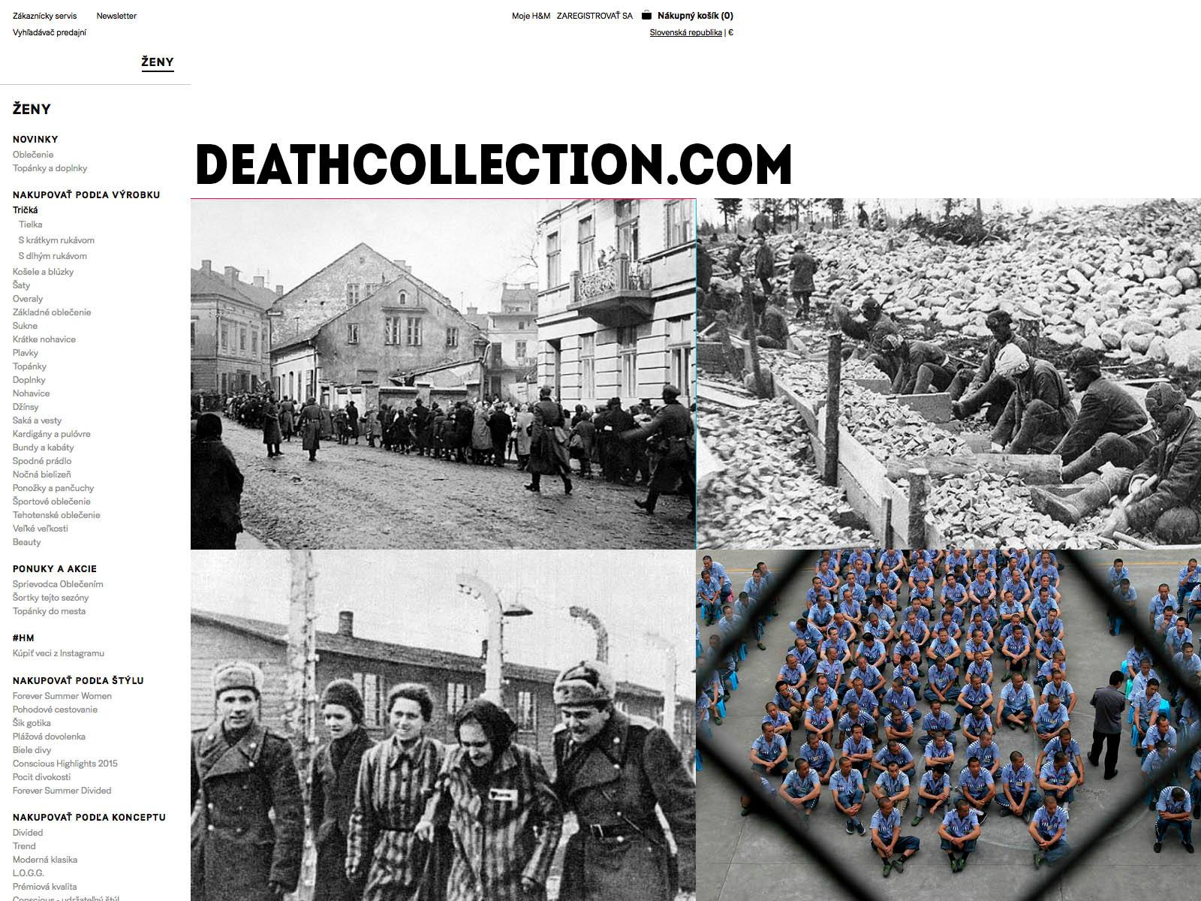
WEBSITE
REVEAL
+learning

